Slide 1
Lunch & Learn
Data Collection Monitoring: Dashboards and Reporting
Ruyi Chen, Ji Qi, Makenna Harrison and Wen Chang
Design, Methodology & Statistical Support
May 2025

Slide 2
Outline
Dashboards and customized reports
The role and benefits of dashboards and customized reports
Data flow, software, design features, visualization options, and distribution
Other measures to consider

Slide 3
Dashboards and customized reports

Slide 4

Car Dashboard

Slide 5
Dashboard
Provide at-a-glance views of key performance indicators relevant to production monitoring
Based on paradata to monitor indicators on costs of interviews, response rates, and non-response error in survey statistics
  Paradata
    Automatic data collected about the survey data collection process
    Captured during computer-assisted data collection
    Includes call records, interviewer observations, time stamps, keystroke data, travel and expense information, and other data captured during the process. (Kreuter et al, 2010)
Tailored audience: study PI, survey director, project manager, production manager
Kreuter, F., M.P. Couper, and L.E. Lyberg. 2010. “The Use of Paradata to Monitor and Manage Survey Data Collection.” In Proceedings of the Joint Statistical Meetings, American Statistical Association, 282–96.

Slide 6
Dashboard
Customized to
  Stages of data collection
    Screening
    Main
  Project-specific needs
    Benchmark
    Sample balance
    PSU and Segment level reports
    Project-specific components (physical measures, biomarkers, consents, etc)
  Facilitate responsive design (Groves and Heeringa, 2006)
    Need to preidentify a set of design features potentially affecting costs and errors of survey estimates
Interactive Features
  Toggle to show the status of an earlier time point
  Toggle to a different subgroup
  Interactive figures (R shiny)
Groves, Robert M.; Heeringa, Steven G. (2006). "Responsive design for household surveys: tools for actively controlling survey errors and costs." Journal of the Royal Statistical Society: Series A (Statistics in Society) 169(3): 439-457.

Slide 7
Dashboard
Core group of metrics
  Key Indicators
  Effort
  Outstanding sample
  Sample balance metrics
  Project-specific components

Slide 8
TL toolkit
Provide at-a-glance views of key performance indicators at the interviewer level
Tailored audience: team leaders and production manager
Features
  TL can filter to see the interviewers in their team
  Average team performance in comparison to overall project performance
  It includes each interviewer's number of completed interviews, contact attempts, completion rate, interviewing hours, and length of interviews, etc.
Notes:
Example: TL- Toolkit- HRS 2024

Slide 9
Other customized reports
Examples
Call Audit Reports
Outlier Report
STARRS TOA Report
PSID Road Runner Report
STARRS SafetyPlan Reportt

Slide 10
The Roles and Benefits of Dashboards and Customized Reports

Slide 11
Monitor Data Collection Progress
Track production yield
  Interim vs finalized case volume
  Number of completes
  Response rate
Understand survey characteristics and respondent behavior
  Breakoff/Suspends
  Mode switch
  Interview length

Slide 12
Monitor Sample Composition
Respondents should be representative of the sample/target population
Help detect sample imbalance (e.g. over- or under-representation of key subgroups)
Inform real-time intervention (e.g. responsive design)
Improve the quality of final survey estimates

Slide 13
Track Field Staff Effort and Performance
Ensure field staff have reasonable workload
Track the hours charged and contact attempts made at individual level
Assess effectiveness of production effort
  Contact rate
  Appointment scheduling and follow up
  Resistance conversion

Slide 14
Assess the Effectiveness of Survey Intervention
Survey project sometimes incorporate new features into data collection, with the hope of improving data collection efficiency or data quality
  Increased TOA
  Different wording of questions
Conduct experiment to assess the effectiveness of such intervention by randomizing respondents to different conditions
Customized report developed to demonstrate the result of such experiment

Slide 15
The roles and benefits of dashboard and customized report
Common themes across projects
  Monitor data collection progress
  Monitor sample composition
  Track field staff effort and performance
  Assess the effectiveness of survey intervention
Project-specific topics
  Customized reports tailored to unique operational and analytic needs

Slide 16
Data flow, Software, Design Features, Visualization Options, and Distribution

Slide 17
Data Flow
Sample Management Systems and Other Data Sources
Data Management
SurveyTrak
MSMS
Summarization and Analysis
Output
Merge
Deploy
FRED
Format
Aggregate
Share with project on Report Portal
Tenrox
Tables
Filter
Descriptive Statistics
Visualizations
Define Metrics
Benchmarks
Interactivity
Projections

Slide 18
Software
R (Shiny & Markdown)
  R Shiny is an open-source package in R that allows users to build interactive web applications
  R Markdown is an open-source package in R which uses markdown syntax to build reports by combining code, analysis, and text into a single document
  Current Project(s): HRS, PSID, ANES
Excel
  Current Project(s): HRS, DAWN
SSRS
  SQL Server Reporting Services (SSRS) is a server-based reporting tool from Microsoft that allows users to design, generate, and manage paginated reports, providing comprehensive data insights with a broad range of visualization options and flexible delivery formats
  Current Project(s): STARRS, PSID

Slide 19
Design Features
Interactivity
  Tables
    Users can use drop-down menus or searches to filter tables by selected sub-groups
      Examples: Date, PSU, Release, Mode, Experimental Conditions, etc.
    Users can sort tables by the values of a chosen column (numerical order, alphabetically)
    Download buttons
  Figures
    Interactive filters can also be applied to figures
    Tooltips
Demo (ANES Pre-Election Dashboard)

Slide 20

Distribution
Distributed on ODS Report Portal: https://srowebint.private.isr.umich.edu/odsportal/

Slide 21
Other measures to consider

Slide 22
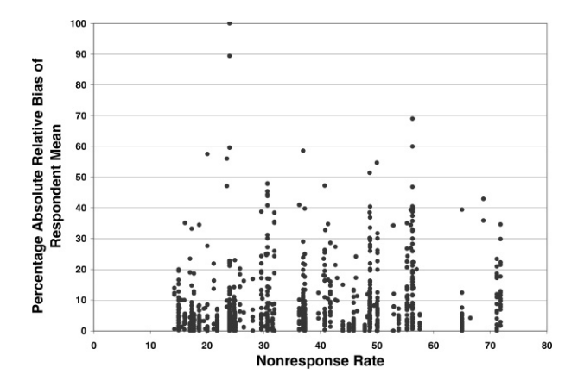
Response Rates and Data Quality Measures
Response Rates are typically used as a data quality measure
However, empirical research suggests weak relationship between (non)response rate and nonresponse bias
Groves & Peytcheva (2008)
Robert M. Groves, Emilia Peytcheva, The Impact of Nonresponse Rates on Nonresponse Bias: A Meta-Analysis, Public Opinion Quarterly, Volume 72, Issue 2, Summer 2008, Pages 167–89

Slide 23
Response Rates and Data Quality Measures
Other measures of data quality in surveys:
  (Coefficient of variation of) Sub-group response rates
  R-Indicators
  Coefficient of variation of response propensities/weights
  Fraction of Missing Information
  Measures of selection/nonresponse bias
    Standardized Measure of Unadjusted Bias (SMUB)
    Measure of Unadjusted Bias for a Proportion (MUBP)
    Standardized Measure of Adjusted Bias (SMAB)
    Measure of Adjusted Bias for a Proportion (MABP)
Some groups at SRC (Future of Surveys initiatives) are currently working on this issue

Slide 24
Interviewer Data Quality Dashboard
Based on Audit Trail Data
Raw indicators
  Average time spent on survey questions
  Frequency of using help screens
  Recording remarks
  Checking errors
  Backing up during the interview
  Frequency of “don’t know” and “refuse” responses.
3 factors: Too fast, Many Error Checks, Many DK/RF (NSFG and HRS)

Slide 25
Propensity-Adjusted Interviewer Performance (PAIP) scores
Incorporating model-based expectations of the difficulty of the tasks (West & Groves, 2013)
  Interview Completion
    For each active case, available paradata is used to estimate the likelihood of completing the survey on the next contact
    Higher credit when completing interviews with more difficult cases
    Higher penalties for failure with easy cases
  Eligibility
  Contact
WEST, B. T., & GROVES, R. M. (2013). A PROPENSITY-ADJUSTED INTERVIEWER PERFORMANCE INDICATOR. The Public Opinion Quarterly, 77(1), 352–374. http://www.jstor.org/stable/24545801

Slide 26
Thank you!
What questions do you have?
Next Lunch & Learn: June 3 (Tuesday)
Mapping and Geocoding

