Slide 1
Survey Process Forum – Staff Projections February 11, 2022

Slide 2
Stakeholders / Objectives of Projections
Employees / Employee Admin Supervisors
Coverage of staff
Opportunities for future assignments
SRO Project Leads
Projected cost to complete / Client communication
Staffing to fulfill work scope
Projects / Clients
Funding available for work scope
Implications of projected variance
SRO Admin
Justification of staff hiring, promotions
Coverage of staff
Assessment of SRO budgeting and project management
SRC
Projection of future Indirects

Slide 3
Deliverables
Monthly Progress Report (MPR)
Client Cost reports (typically monthly)
SRC Cost Reporting (e.g. Overrun Report)

Slide 4
Tools
PDMG Allocation Spreadsheet
Not linked to CRS/RFT
Updated manually
Ideally includes assignments not yet in CRS
Other Unit Allocation Tracking tools?
Reports prepared for or by SRO Admin showing staff coverage
ET and Tenrox Reports
Cost Reports
Resource Forecasting Tool 3 (RFT3)
Other?

Slide 5
CRS
Cost Reporting System
Purpose: Financial Reporting and Planning
Primary Users: FSG and Project Managers
Employee Hour Projection data is queried from CRS data sets to display in RFT
RFT
Resource Forecasting Tool
Purpose: Resource Planning
Primary Users: Supervisors,
Project Managers, Individuals
Project projections created or modified in RFT DO NOT update automatically in CRS. The changes will first be routed to the project’s financial analyst.

Slide 6
RFT3 Capabilities
Viewing Projections; Projections can be viewed by:
Person
Supervisor
Project
Department
Creating/Modifying Projections
New Projects
Existing Projects/Overhead/Recharges
SHV

Slide 7
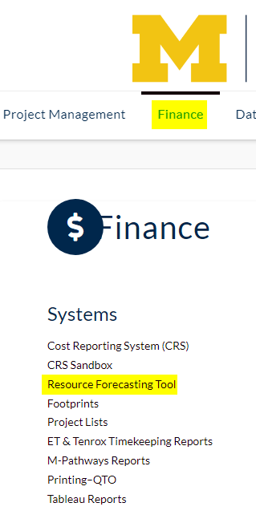
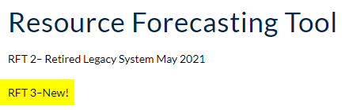
RFT3 Demo

Slide 8
Discussion Topic Ideas
Managing RFT Projection Updates
Communication and Responsibilities
Depicting projections for Biweekly Staff more clearly in RFT
Reducing Over Projection of Staff
Suggestions for future systems mods?

Slide 9
Managing RFT Projection Updates
Frequency of mods by employees, supervisors, project leads, etc.
Workflow: RTF→Discussion→CRS Update→RFT Correction?
Removal of RFT added projects when officially added to CRS

Slide 10
Communication and Responsibilities
Projects not yet in RFT or staffed
Staff assignments to projects and changes in project needs (schedule shifts)
Interpretation of OH and Recharge account projections
Staff ooto
Project Leads to employees / admin supervisors (monthly)
Resolution of resource conflicts

Slide 11
Depicting projections for Biweekly Staff more clearly in RFT
Hours as they’re worked vs Hours as they will hit
Possibly revert to “hours as they’re worked” display?
Have CRS or RFT projections entered by week (for full precision)?
And/or add more reference info about the alternate view?

Slide 12
Reducing Over Projection of Staff
Ensuring Staff aren’t projected more than their fraction.
Better reflecting planned ooto
How should projects reflect needs that might be unstaffed/unmet

Slide 13
Suggestions for future systems mods?
Mods to RFT3 to reduce reliance on other systems?
Other?

Slide 14
Goals in Monthly CRS Review
Review actuals from previous month. Confirm plausibility. Identify errors. Assess variance.
Coordinate with staff and functional/admin supervisors
Noting of project actuals that were staff training time
Noting hours that are worked but never charged due to exempt staff working >40 hrs/wk.
Review future projections. Confirm plausibility. Update as needed.
Coordinate with staff and functional/admin supervisors

