Slide 1
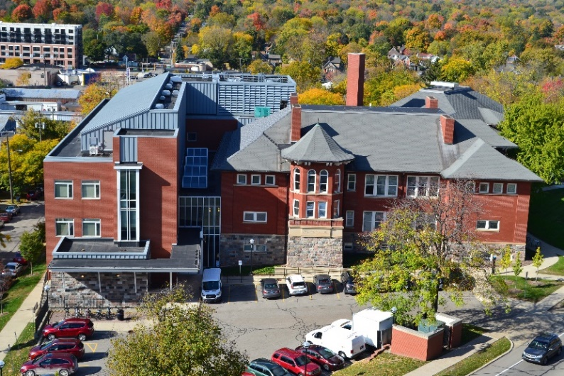

SRO Business Meeting September 25, 2018

Slide 2

SRO Business Meeting Schedule
12:30-1pm
Lunch by Zingermans. Please enjoy!
1-4pm
Business Meeting

Slide 3
SRO Business Meeting Agenda
Welcome
Report from our Director
Guest Presentation
ICPSR: Linda Detterman & Jared Lyle
Keynote Address: Data Visualization
University of Michigan Library Services: Justin Joque
Break
New Staff Introductions
SRO Financial Report
SRO Projects on the Horizon
Closing

Slide 4

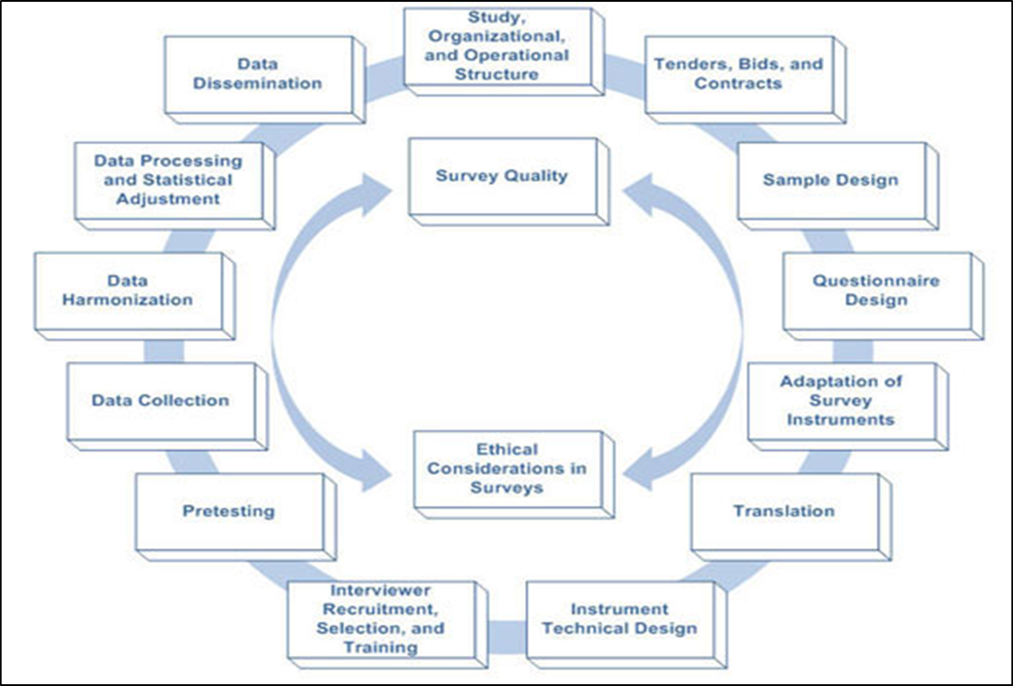
The ISR Mission & the Survey Lifecycle

Slide 5

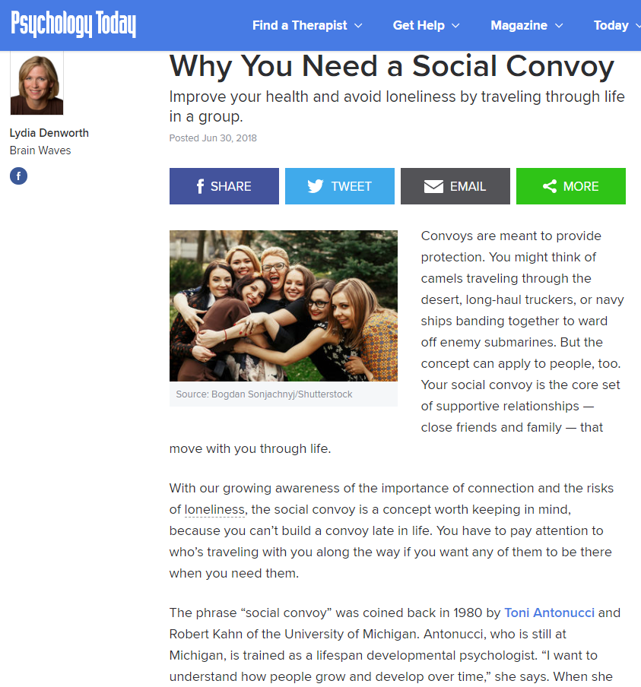
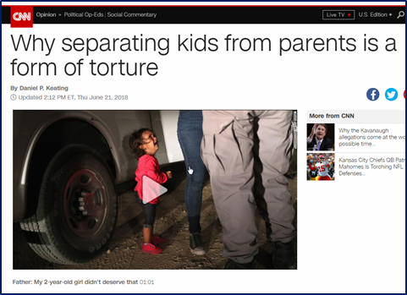
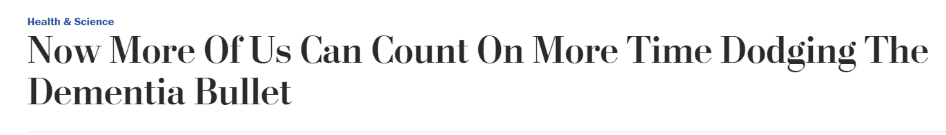
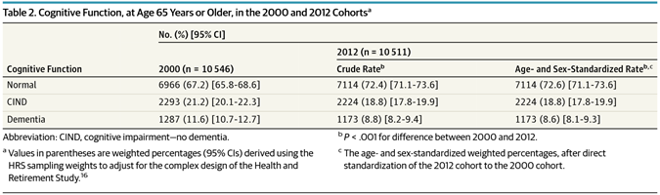
Today’s Theme: Our Data in the World

Slide 6

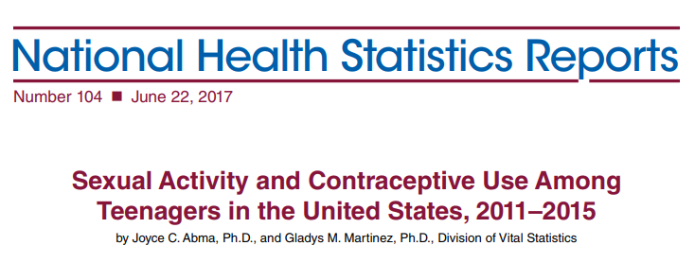
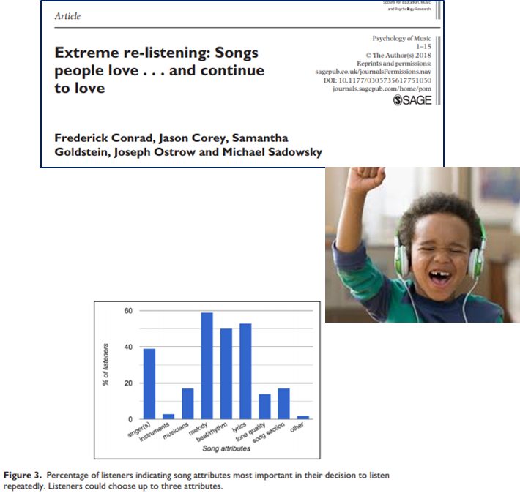
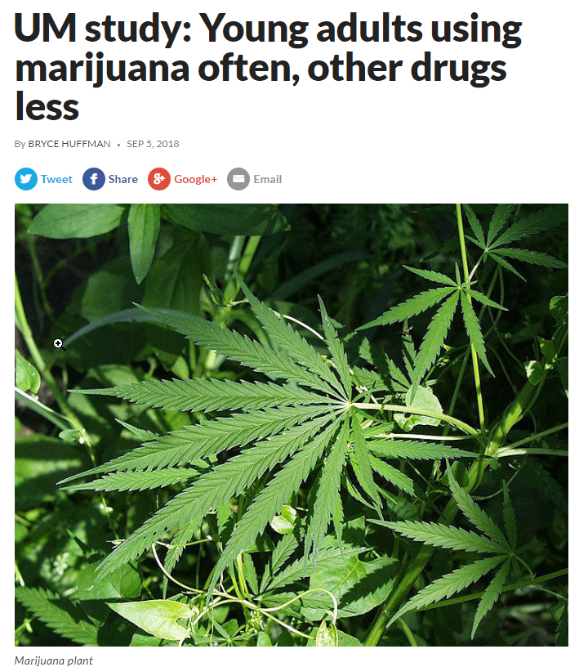
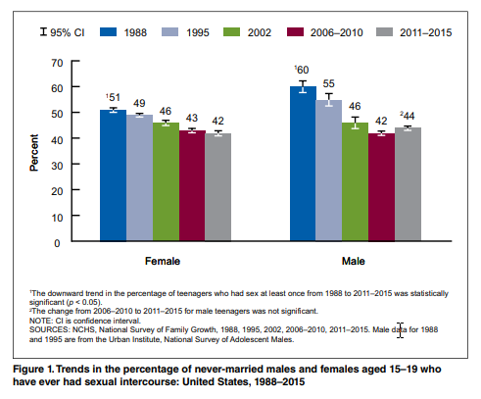
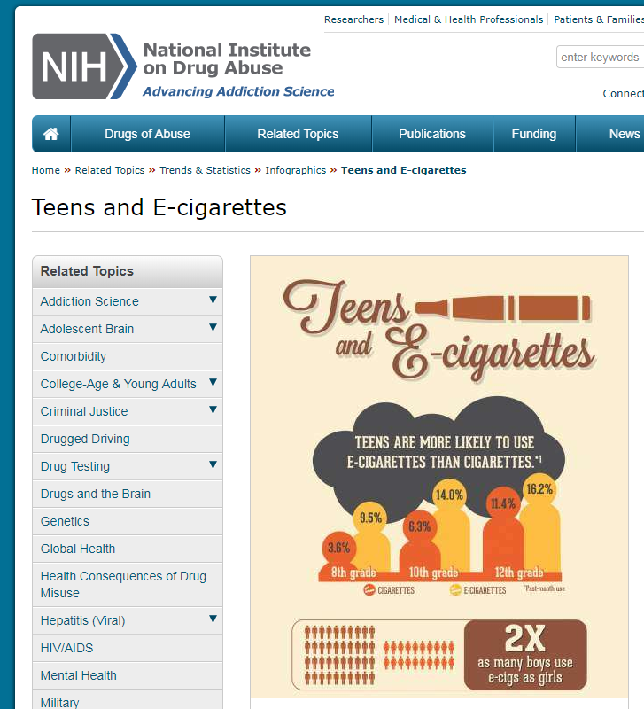
Today’s Theme: Our Data in the World

Slide 7
Today’s Theme: Our Data in the World

Slide 8

Today’s Theme: Our data in the world
Data Collection
Data Processing
Data Dissemination

Slide 9

Report from our Director
Looking Back -- last year, sponsored projects +
Looking at Today -- Sponsored and developmental projects
Looking Ahead – Processes, Projects and People
Questions

Slide 10
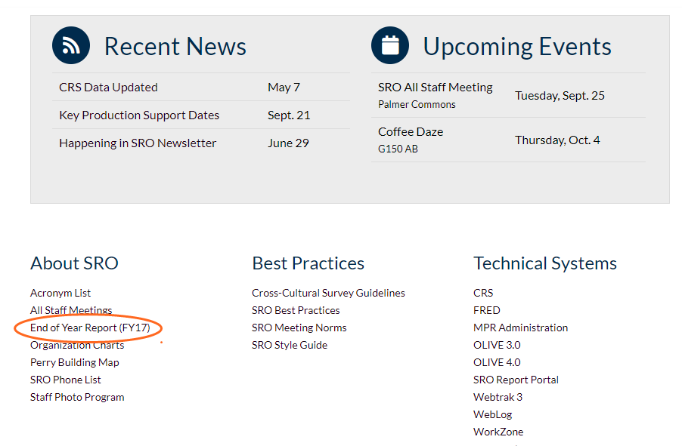
End of Year (FY18) Report … about Ready
Look for this soon…
Details of key activities in SRO
Great work!
FY18
Soon…

Slide 11
Last Year (FY18)
We had a very good year; sponsored projects
Volume (research $ through SRO) up
Higher than we had anticipated …
Trend is strong/positive looking across the past several years
Notes:
Looking at volume == very good news
Not the only way to look this

Slide 12
 | Actuals
 | 2014 | 2015 | 2016 | 2017 | 2018
Indirect Costs and Fees | 7,586,152 | 7,770,512 | 10,162,839 | 11,828,396 | 11,665,774
Direct Costs | 22,531,833 | 19,967,223 | 26,113,322 | 31,429,950 | 30,836,733
Total Sponsored Costs | 30,117,985 | 27,737,734 | 36,276,161 | 43,258,346 | 42,502,506
Effective Rate (IDC) | 33.7% | 38.9% | 38.9% | 37.6% | 37.8%
Super Big…
Notes:
Ryan – will talk a bit more about the detail on our financial picture.

Slide 13
Right Now = Very Good Mix of Projects
Keeping our interviewers employed!

Slide 14
Current Year (FY19)
FY 19 - Sponsored
Costs | Base Estimate | Upper Estimate
Direct | 25,633,532 | 27,087,703
Indirect | 9,920,734 | 10,727,510
Total | 33,554,267 | 37,815,213
IDC% | 38.70% | 39.60%
Developmental projects, and related initiatives
Significant increase; more diverse
Single and mixed modes* sponsored projects
Challenges for project complexities
Adopting to new software platforms while in production
SRO Staffing → snapshot

Slide 15
SRO Staffing and Hiring
Postings Active ~ 7 additional SRO Staff Positions

Slide 16
Looking Ahead – Processes, Projects and People
Change ~ nature of our work
Adapt to new processes related to data collection strategies
Exciting upcoming launches for (new) projects
SRO Leadership -- New Director and Associate Director

Slide 17
Questions/Comments …

Slide 18
Guest Presentations
Getting to Know ICPSR: Linda Detterman & Jared Lyle
Data Visualization: Justin Joque, University of Michigan Library

Slide 19

Break Time!

Slide 20
New Staff Introductions

Slide 21
SRO Financial Report

Slide 22
SRO All Staff
Financials
September 2018

Slide 23
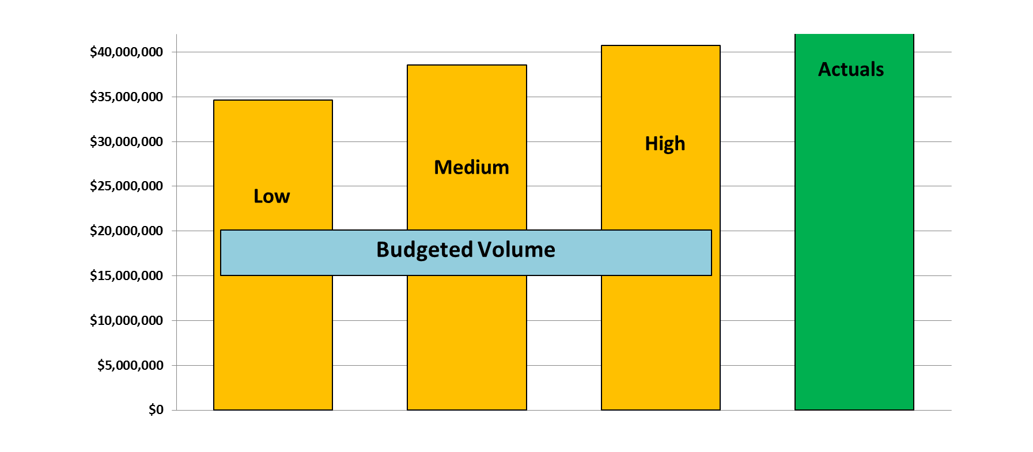

FY18 - How Did We Do?

Slide 24
FY19 -Our Current Outlook
Notes:
1

Slide 25
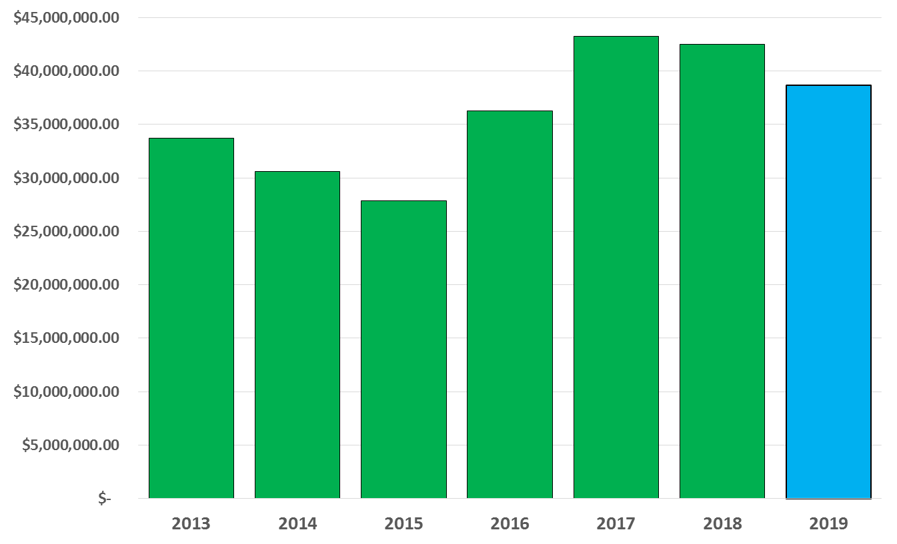
Volumes Trending Over Time

Slide 26
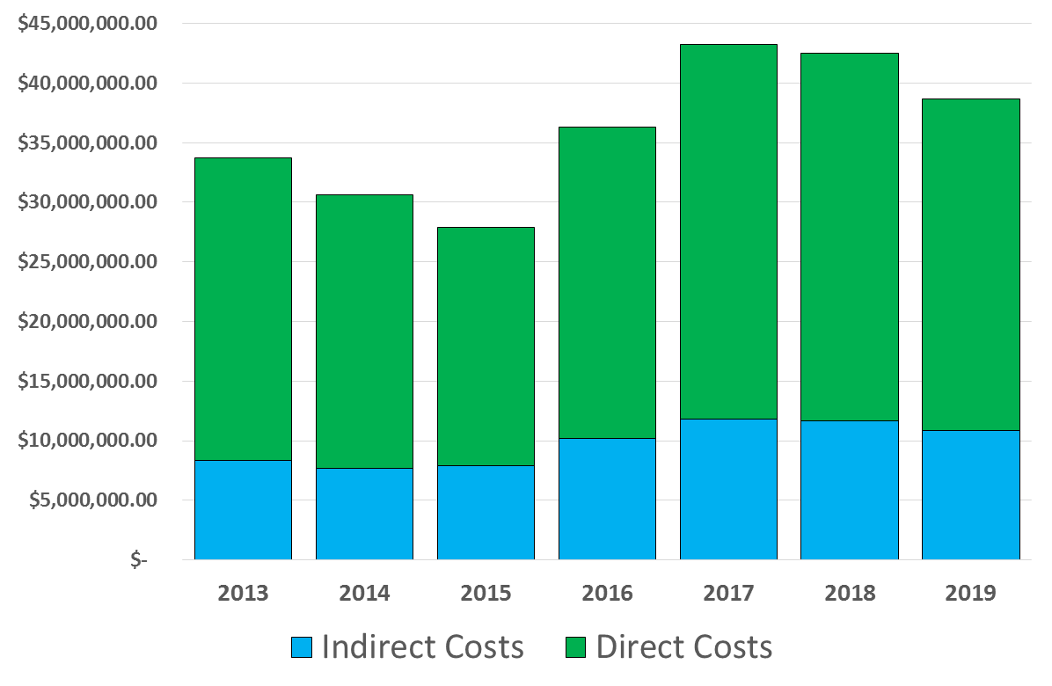
Direct and Indirect Revenues

Slide 27
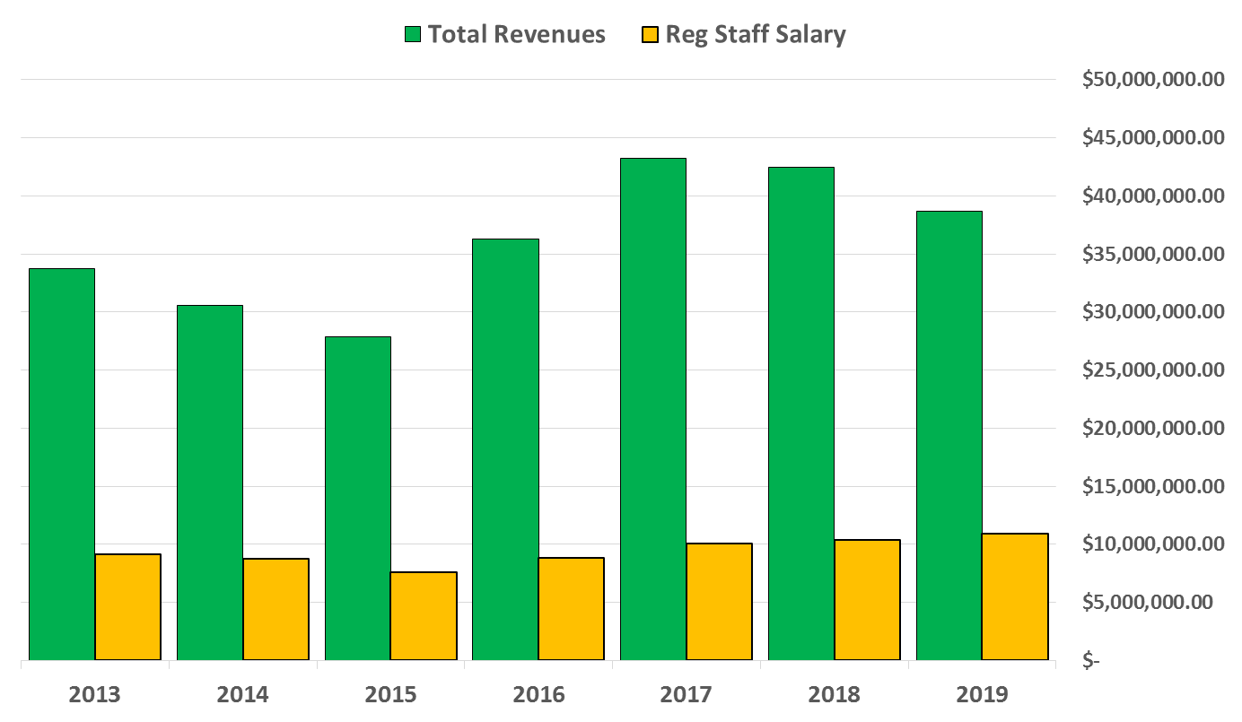
Revenues Compared to
Regular Staff Salary Costs

Slide 28
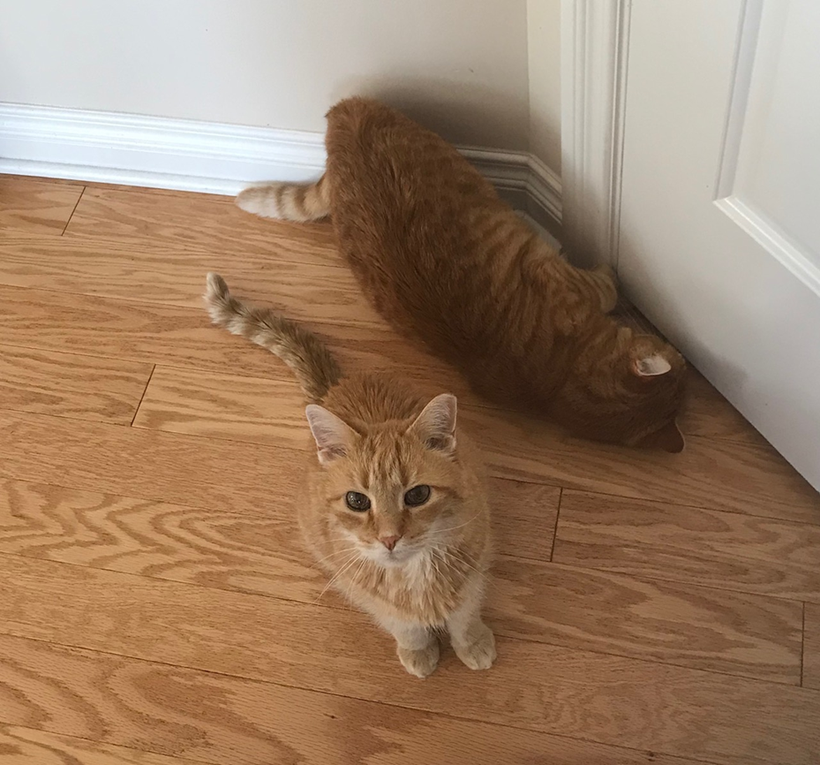
Questions?

Slide 29
SRO Projects on the Horizon

Slide 30
SRO Projects on the Horizon
Some proposal data from FY2018
So far in FY2019…
Newly funded/upcoming projects
Interesting pending proposals

Slide 31
Review of Proposal Group Activity

Slide 32
Review of Proposal Group Activity

Slide 33
Review of Proposal Group Activity
So far in FY2019 (just since July!)…
We have submitted 12 ballpark budgets
Total value = $14,680,510
We have submitted 14 formal proposals
Total value = $4,611,530
We have 13 different budgets in our current proposals list, and we continue to triage new requests and inquiries every week – many of which turn into new budgets

Slide 34

Newly Funded/Upcoming Projects

Slide 35

Variation in Early Mathematics Instruction Across Grades and Schools
SRC’s new-ish program Youth Policy Lab (joint with Ford School)
NYC schools that participated in program designed to improve pre-K math skills in low-income kids (“High 5s”)
SRO staff will conduct classroom observations in 10 High 5s schools and 10 control schools
Standard observation assessment will be done in kindergarten and 3rd grade classrooms
Fall 2018 and Spring 2019

Slide 36
Americans’ Changing Lives (ACL) Wave 6
Official title: “Social Stress and Vulnerability to Environmental Toxicants: Epigenomic Pathways to Health Inequalities” !
Continuation of long-standing SRC panel; transition to new PI
Contact ~1450 surviving ACL panel members to complete 60-minute telephone interview (SSL)
Detailed collection of roster of children who have ever been in these ACL households, in preparation for a supplemental proposal and data collection
Consent to schedule in-home blood draw with phlebotomist, and follow-up with respondents
Data collection start in Spring 2019

Slide 37

Video Communication Technologies in Survey Data Collection
Purely methodological project, with leadership from SRC’s Survey Methods Program
Impact of human visual contact during survey interaction – live interviewer on video, recorded interviewer on video, or traditional web survey
~720 cases assigned across three conditions
Respondents first complete brief web screener
Data collection from SSL
Same interviewers conducting interviews will also be video recorded
Opportunity to develop new technology for integrating video with surveys
Data collection start in Spring 2019

Slide 38

Child Development Study (CDS)
CDS-2019 is the 5th wave of data collection
~3600 PSID families will be included
Components include interview with primary caregiver, child interview, child assessment, time diaries, saliva collection, administrative records consent
Additional funding to collect saliva samples from other household adults
Plan is to complete 100% of the households in-person…
SRO activity has started; data collection September 2019 – April 2020
Overlap with PSID Core-2019 and PSID TAS-2019…

Slide 39
A More Efficient Web-based Approach to Collecting National Family, Fertility, & Reproductive Health Data
Another primarily methodological project
Is there a more cost effective way (self-administered) to collect high-quality data on studies like NSFG?
Large initial sample size split over 2 cohorts
Address-based national sample
Mailing with request to complete brief screener/prepaid incentive experiment
Eligible respondents invited to complete 3 survey modules, mail or web
Centralized telephone follow-up to non-responders
Comparison of actual survey data to NSFG public use files
Data collection starts September 2019

Slide 40
And More That is Funded…
Two related India projects
India Data Innovations Center and India Human Development Survey III
Making Ends Meet
CARE
DoD-NCAA concussion study
World Mental Health (WMH)
Launch of new countries using new Blaise 5 version of CIDI
Turkey, Norway, Qatar, Iran, Philippines

Slide 41
Interesting New Proposals
Social Relations (reinterview of panel + recruitment of new cohort)
Generations and Gender Programme (U.S. component of cross-national survey)
Puerto Rico Panel Study of Migration Dynamics (replication of PSID)
Reproductive Health, Intimate Relationships, and College Completion (reinterview of RDSL/MSYW respondents)
Various Army STARRS and STARRS-LS extensions and supplements
Kazakhstan Survey Methods Workshop (capacity building)

Slide 42
Questions?

Slide 43
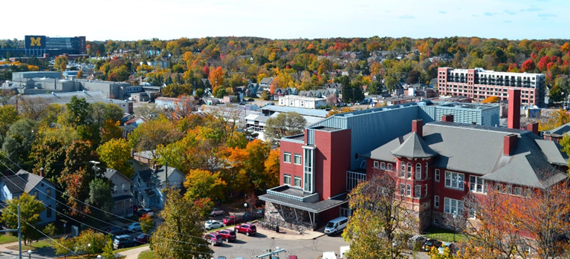
Thank You!

